Slide 1
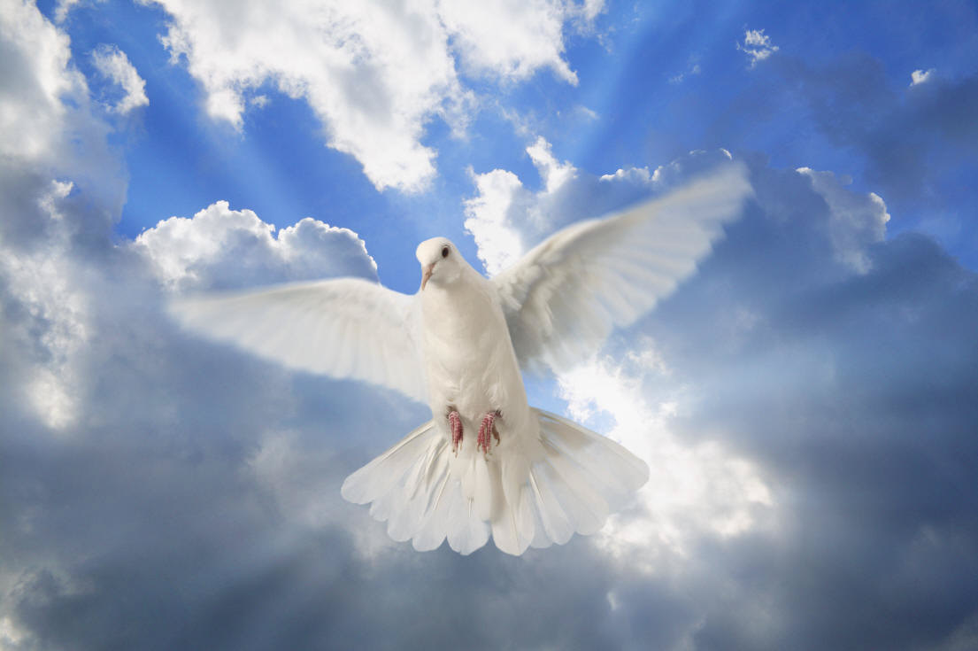
"We Shall Behold Him"
Sung by Sandi Patti
Dr. Rick Griffith • Jordan Evangelical Theological Seminary • BibleStudyDownloads.org
Notes:
1

Slide 2

The sky shall unfold…
Notes:
2

Slide 3

…preparing His entrance
Notes:
3

Slide 4
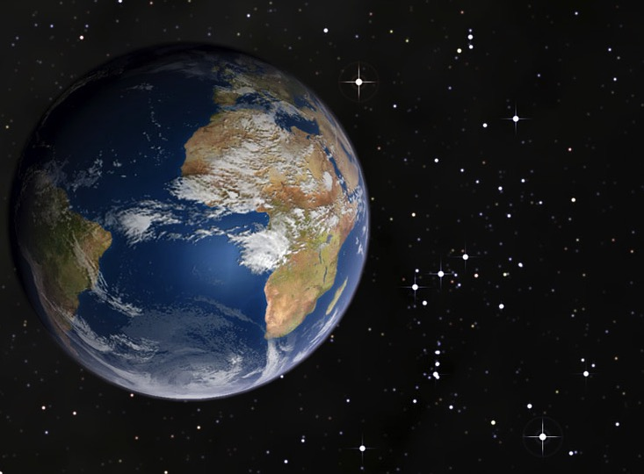
The stars shall applaud Him with thunders of praise

Slide 5

The sweet light in His eyes shall enhance those awaiting
Notes:
5

Slide 6

And we shall behold Him then face to face
Notes:
6

Slide 7
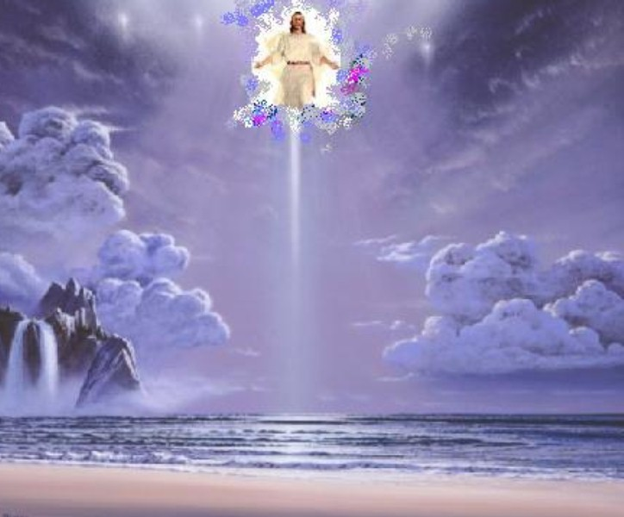
We shall behold Him
We shall behold Him
Notes:
7

Slide 8

…face to face in all of His glory
Notes:
8

Slide 9

We shall behold Him
We shall behold Him
Notes:
9

Slide 10

…face to face, our Savior and Lord
Notes:
10

Slide 11
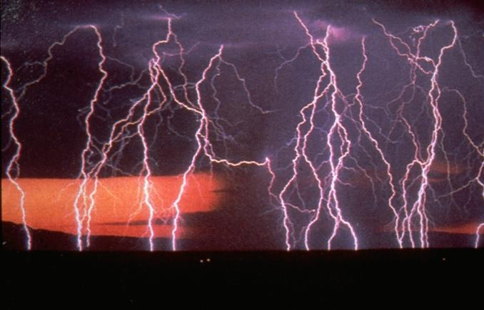
The angels shall sound the shout of His coming
Notes:
11

Slide 12
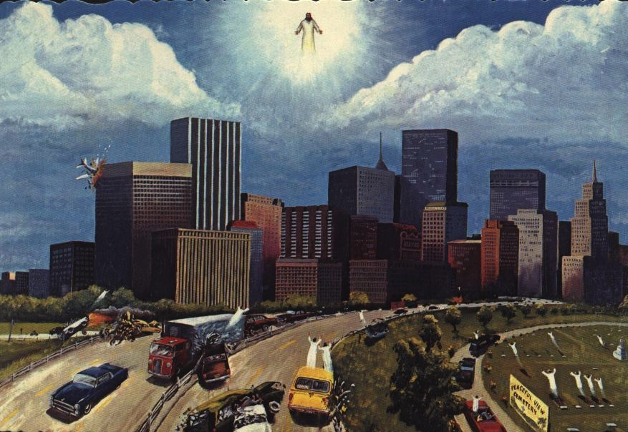
The sleeping shall rise from their slumbering place
Notes:
12

Slide 13

And those who remain shall be changed in a moment
Notes:
13

Slide 14

And we shall behold Him then face to face
Notes:
14

Slide 15
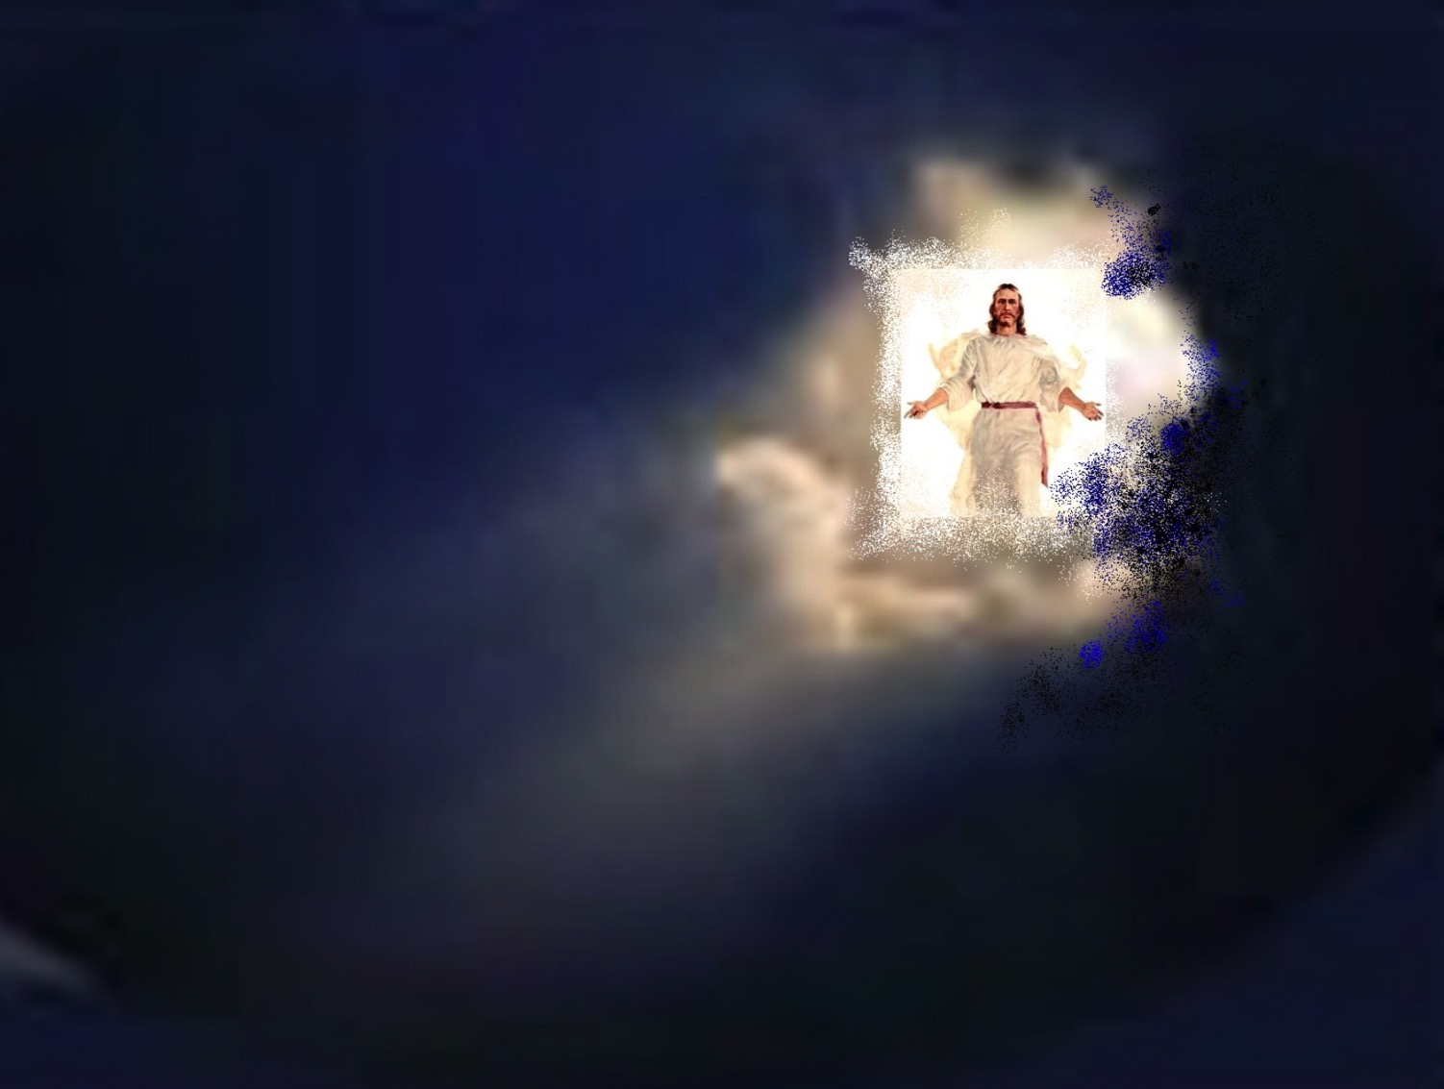
We shall behold Him
We shall behold Him
Notes:
15

Slide 16

…face to face in all of His glory
Notes:
16

Slide 17
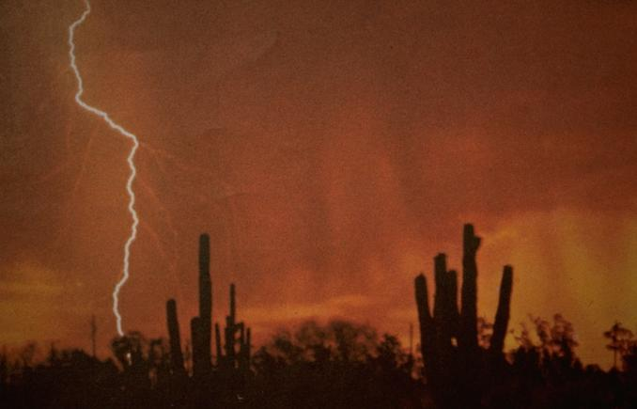
We shall behold Him
We shall behold Him
Notes:
17

Slide 18
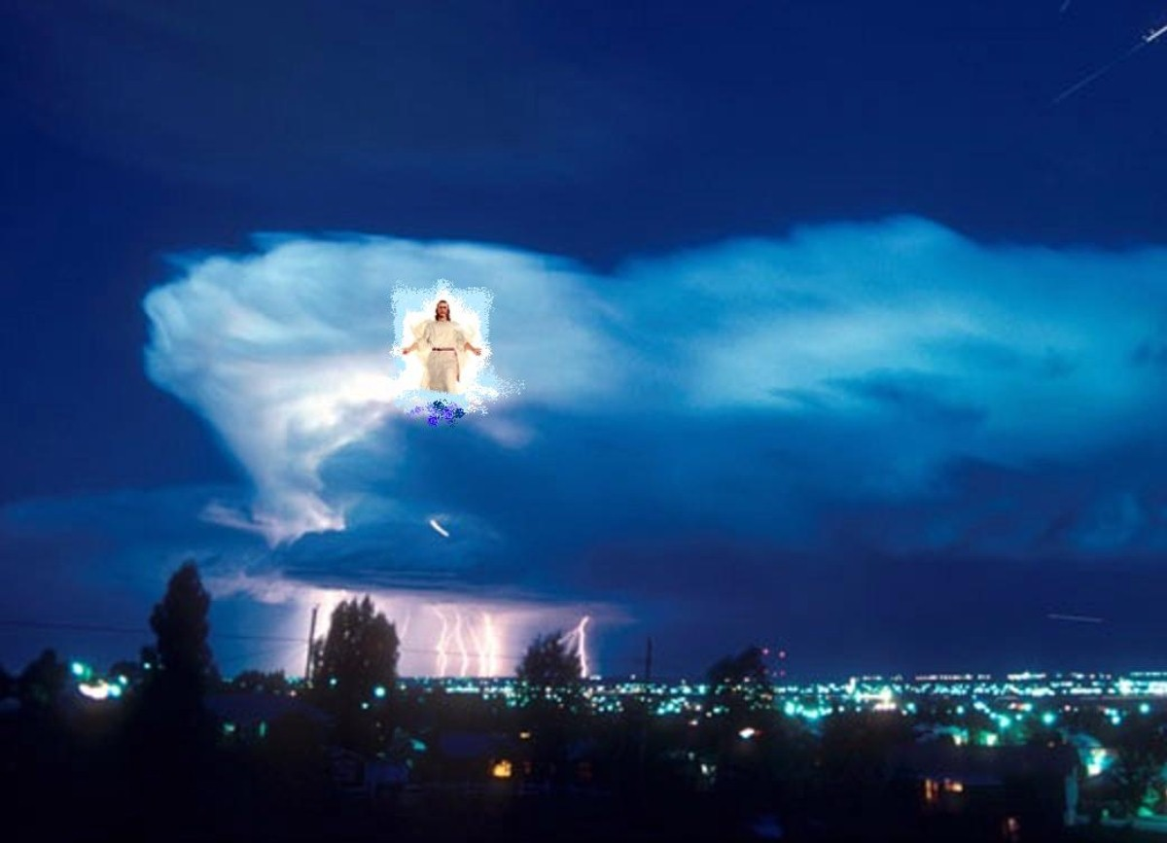
…face to face, our Savior and Lord
Notes:
18

Slide 19

We shall behold Him, our Savior and Lord!
Notes:
19

Slide 20
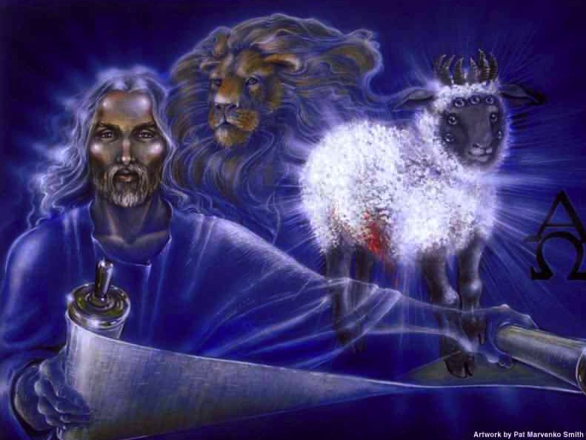
...our Savior and Lord!
Notes:
20

Slide 21
Black

Slide 22


Future (Eschatology) at BibleStudyDownloads.org
Get this presentation for free!
Notes:
Future (fu)
Eschatology

